Slide 1
In the Beginning Was the Word
Unveiling the Mystery of John's Prologue
John's Prologue is not merely an introduction to a Gospel — it is the theological foundation of the entire Christian faith. In 18 verses, the Apostle John reveals who Christ is, where He came from, why He entered creation, and what His coming means for every human soul.The Orthodox Church has meditated on these verses for two millennia, and the Church Fathers devoted entire treatises to unpacking their depth. Over the next slides, we will walk through this passage verse by verse, guided by their wisdom.
[Byzantine Icon of St. John the Theologian Placeholder]
John 1:1–18 | Slide 1 of 15
Notes:
Welcome the congregation. Set the tone: this isn't a lecture, it's a guided meditation through 18 of the most important verses ever written. Mention that John's Prologue is the Gospel reading for Pascha night — the Church placed it at the most sacred moment of the liturgical year for a reason. Let people know each slide stands on its own — they can photograph slides and revisit them later. This journey follows the Church Fathers, not personal opinion.

Slide 2
In the beginning was the Word
Ἐν ἀρχῇ ἦν ὁ Λόγος — John 1:1a
John deliberately echoes Genesis 1:1 ('In the beginning, God created...'). But notice the difference: Genesis says God created — an action with a starting point.
John says the Word was — already existing, without origin. The Greek word 'ἦν' (ēn) is imperfect tense, meaning continuous, unbroken existence.
The Word did not come into being at the beginning — the Word already was when the beginning began.
St. John Chrysostom (Homilies on John, Homily 2): “Where is the beginning? He took the first place above all. The word was indicates no commencement; it shows a prior existence.”
Think of it like this — when you open a book to page one, the author already existed before writing it. The 'beginning' of the story is not the beginning of the author.
John is telling us: before anything was created, the Word was already there. Not born, not made — simply was.
John 1:1a | Slide 2 of 15
Notes:
Pause on the word 'was.' Let it land. The Greek imperfect tense carries enormous weight here — it's the difference between 'came into being' and 'always existed.' Chrysostom spent an entire homily on this single clause. If someone asks 'but what was before the beginning?' — John's answer is: the Word. That's it. No origin story for God. He simply was.

Slide 3

AND THE WORD WAS WITH GOD
καὶ ὁ Λόγος ἦν πρὸς τὸν Θεόν — John 1:1b
Theological Meaning ('Pros') | Patristic Insight | Practical Analogy
The Greek preposition 'πρὸς' (pros) is crucial. It implies face-to-face relationship, active communion, and dynamic presence. The Word was not passively next to God, but in eternal, intimate communion with the Father. This verse establishes that the Word (the Son) is a distinct person from the Father—not the same person wearing a different mask (Modalism), but a separate hypostasis in eternal relationship. | St. Gregory the Theologian (Oration 29): "The Son is other than the Father in the sense of personhood, not in the sense of nature or divinity." | A parent and child share the same human nature — both are fully human. Yet they are distinct persons. In a far more perfect and eternal way, the Father and the Son share one divine nature while being distinct persons, always existing in loving communion.
John 1:1b | Slide 3 of 15
Notes:
The word 'pros' is doing heavy theological lifting. It's not static — it's dynamic, relational. The Trinity is not three gods having a meeting. It's one God whose very nature IS relationship. Rublev's icon captures this better than any textbook: three persons, one table, one cup, each oriented toward the others. Point out the circular composition of the icon — the love flows endlessly between the three.

Slide 4
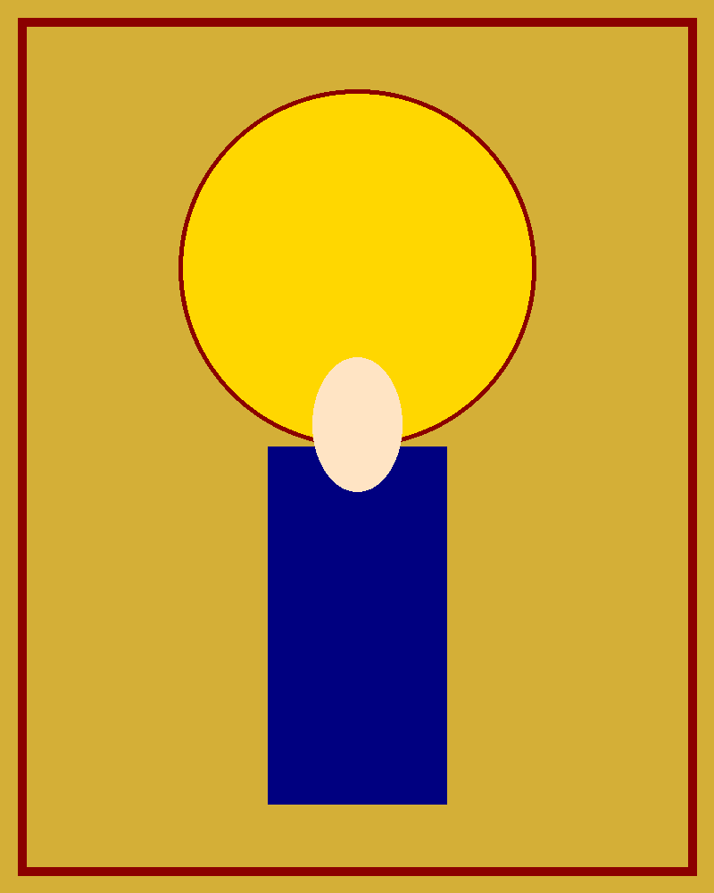
And the Word was God
καὶ Θεὸς ἦν ὁ Λόγος — John 1:1c
This is the verse that defines Christian orthodoxy. The Word is not a god (lowercase). The Word is not less than God. The Word IS God — fully, completely, without qualification.
In Greek, 'Θεὸς' (Theos) appears without the definite article, which some have misused to argue the Word is a lesser deity. But Orthodox and mainstream biblical scholarship unanimously rejects this reading. The anarthrous construction indicates nature and quality — John is saying the Word possesses the full divine nature.
Heresies Addressed
Arianism (4th c., Arius of Alexandria): Claimed the Son was created — 'there was a time when He was not.' Condemned at the Council of Nicaea (325 AD). The Nicene Creed responds: 'God from God, Light from Light, True God from True God, begotten not made, of one essence with the Father.'
Jehovah's Witnesses (modern Arianism): Translate as 'the Word was a god' — grammatically and theologically indefensible, rejected by virtually all Greek scholars.
St. Athanasius (On the Incarnation): "He was not first human and then became God; He was first God and then became human — so that He might make us gods."
John 1:1c | Slide 4 of 15
Notes:
This is where the rubber meets the road. Every major Christological heresy of the first four centuries crashed against this verse. Arius couldn't get around it. The Nicene Fathers built their creed as a direct fortress around it. If anyone in the congregation has ever encountered Jehovah's Witnesses at their door arguing 'a god,' here's the answer — it's not just theology, it's Greek grammar. The anarthrous predicate nominative construction in Greek indicates quality, not indefiniteness.

Slide 5

"In Him was life, and the life was the light of men. The light shines in the darkness, and the darkness has not overcome it." — John 1:4–5
Two foundational metaphors now enter: life and light. The Word is not simply alive — He is the source of life itself. Every living thing derives its existence from Him. And this life radiates outward as light — illumination, truth, knowledge, goodness. Orthodox theology calls this the 'uncreated light' (ἄκτιστον φῶς) — the divine energy of God that penetrates creation without being part of creation.
The darkness — sin, ignorance, death, evil — attempts to extinguish or comprehend (κατέλαβεν can mean both 'overcome' and 'comprehend') this light. It fails on both counts. The darkness cannot defeat the light, and it cannot understand it. This is not a battle between equals. Light does not struggle against darkness — it simply shines, and darkness ceases to exist wherever light reaches.
Patristic Block
St. Gregory Palamas: The uncreated light experienced by the apostles at the Transfiguration on Mt. Tabor is the same divine light John speaks of — God's own energy, accessible to believers through prayer and sacrament.
Practical Block
When you walk into a dark room and flip the light switch, you never see the darkness fighting back. It simply vanishes. That is the nature of Christ's light — it does not negotiate with evil, it displaces it. Our role is to remain in that light.
John 1:4–5 | Slide 6 of 15
Notes:
Gregory Palamas is essential here. The uncreated light isn't metaphorical in Orthodox theology — it's God's actual energy, His mode of self-communication. The Transfiguration is the proof: Peter, James, and John saw it with their physical eyes. That same light is available to every believer. The light-switch analogy is deliberately simple because the truth is simple: darkness is not light's equal. It never was.

Slide 6

"There was a man sent from God, whose name was John. He came as a witness, to bear witness about the light, that all might believe through him. He was not the light, but came to bear witness about the light."
— John 1:6–8
John the Evangelist pauses the cosmic theology to introduce a human figure: John the Baptist. Notice the deliberate contrast in Greek — for the Word, John uses 'ἦν' (was, continuous existence). For the Baptist, he uses 'ἐγένετο' (came into being, a created event). The Baptist had a beginning. The Word did not.
The Baptist's role is clearly defined and clearly limited: he is a witness, not the source. A witness points beyond himself. A mirror reflects light but does not generate it. This is the model for every preacher, teacher, and believer — we do not create truth, we point to the One who is Truth.
Orthodox Pastoral Application
In the Orthodox tradition, this is why icons of John the Baptist always show him pointing toward Christ — his entire identity is oriented away from himself and toward the Lamb of God. Every Christian's calling is the same: to be a witness who directs others toward the Light, never claiming to be the light ourselves.
John 1:6–8 | Slide 7 of 15
Notes:
The verb switch from 'ēn' to 'egeneto' is deliberate and devastating. John the Evangelist is a careful writer — every word choice matters. The Baptist came into being at a specific moment. The Word never did. And the Baptist's whole life models what every Christian leader should be: a finger pointing at Christ, not a mirror reflecting themselves. Ask the congregation: who in your life has been a 'Baptist' for you — someone who pointed you toward Christ?

Slide 7

“The true light, which gives light to everyone, was coming into the world. He was in the world, and the world was made through Him, yet the world did not know Him. He came to His own, and His own people did not receive Him.” — John 1:9–11
Here is the great tragedy of the Prologue. The Creator enters His own creation — and creation does not recognize its Maker. The One through whom the world was made walks through that world as a stranger. “His own” refers specifically to Israel — the people God chose, prepared through centuries of prophecy, covenant, and revelation — and they rejected Him.
This is not a failure of God's plan but a revelation of humanity's condition. Orthodox theology calls this the depth of the Fall — sin has so distorted human perception that we cannot recognize our own Creator standing in front of us. It is not that the light was dim; it is that our eyes were diseased.
St. Cyril of Alexandria (Commentary on John, Book 1):
“He came to those who were His own by right of creation and by right of covenant, and they turned away from their own salvation.”
Have you ever failed to recognize someone you know well because you encountered them in an unexpected context?
Christ came not as a conquering king with armies but as a humble carpenter's son from Nazareth. Israel expected a political messiah and missed the divine one. We must ask ourselves: in what ways might we also be failing to recognize Christ — in the poor, in the suffering, in the sacraments, in one another?
John 1:9–11 | Slide 8 of 15
Notes:
Let the tragedy sit. Don't rush past it. The Creator walks into His own workshop and the furniture doesn't recognize the carpenter. Israel had every advantage — the Law, the prophets, the covenants — and still missed Him. The question to the congregation is personal and uncomfortable: where are we missing Christ right now? In the homeless person outside? In the difficult neighbor? In the Eucharist we receive routinely?

Slide 8

Rejection & Divine Gift: Theosis
"But to all who did receive Him, who believed in His name, He gave the right to become children of God, who were born, not of blood nor of the will of the flesh nor of the will of man, but of God."
— John 1:12–13
After the tragedy of rejection comes the astounding gift: those who do receive Christ are given the 'right' (ἐξουσίαν — authority, power, privilege) to become children of God. This is not a natural birthright or a human achievement — it is a gift. You cannot earn it through bloodline ('not of blood'), physical effort ('not of the will of the flesh'), or human authority ('not of the will of man'). It comes from God alone.
Key Orthodox Concept — Theosis (θέωσις):
This verse is foundational to the Orthodox doctrine of theosis — divinization. To become 'children of God' is not merely a legal status or metaphor. Orthodox theology teaches that through Christ, humans are invited to participate in the divine nature itself (2 Peter 1:4). We do not become God by essence — that is impossible. But we become 'gods by grace' — sharing in God's life, His holiness, His love, His immortality. This is the ultimate purpose of human existence.
Patristic Insight
St. Athanasius (On the Incarnation, §54): 'God became man so that man might become god.' — Perhaps the single most important sentence in Orthodox theology.
Practical Analogy
Think of an iron rod placed in a fire. Over time, the rod glows with the fire's heat and light. The rod does not become fire — it remains iron. But it participates so fully in the fire's energy that it radiates heat and light as if it were fire itself. This is theosis: we remain human, but we are so filled with God's grace that His life radiates through us.
John 1:12–13 | Slide 9 of 15
Notes:
Theosis is the heart of Orthodox soteriology and most congregants have heard the word but struggle to explain it. The iron-in-fire analogy is from the Fathers themselves and it lands every time. Stress the triple negative: not blood, not flesh, not human will. This shuts down every form of spiritual elitism — no one earns this. The Athanasius quote should be memorized by every Orthodox Christian. It summarizes the entire faith in one sentence.

Slide 9

And the Word became flesh and dwelt among us
Καὶ ὁ Λόγος σὰρξ ἐγένετο καὶ ἐσκήνωσεν ἐν ἡμῖν — John 1:14a
The eternal, uncreated Word 'became flesh' (ἐγένετο).
Not a costume or an appearance. It was a real, permanent, irreversible event.
God took on full human nature (body, soul, mind, will) without ceasing to be fully God.
'Dwelt' (ἐσκήνωσεν) literally means 'pitched His tent' or 'tabernacled.'
Recalls the Old Testament Tabernacle (Exodus 40:34-35).
The portable tent of meeting is now a human body.
Heresies This Verse Refutes:
Docetism: Refutes the claim that Christ only appeared human.
Apollinarianism: 'Flesh' signifies complete human nature, not just a physical shell.
Nestorianism: The one Word became flesh — one person, two united natures.
The Chalcedonian Definition (451 AD):Christ is one person in two natures — fully divine and fully human — 'without confusion, without change, without division, without separation.'
St. Maximus the Confessor:"The Incarnation is the ultimate purpose of creation. God always intended to unite Himself with humanity — the Fall made it a rescue mission, but union was always the plan."
John 1:14a | Slide 10 of 15
Notes:
This is the climax of the Prologue. Slow down. Let the congregation feel the weight. The eternal God — the one we've been describing for nine slides as infinite, uncreated, beyond all comprehension — squeezed Himself into a human embryo in a teenage girl's womb in a backwater town. That's what 'became flesh' means. Maximus's insight is staggering: the Incarnation wasn't Plan B after the Fall. It was always Plan A. God always intended to unite with us. Sin just made the union a rescue operation.

Slide 10

"John bore witness about Him, and cried out, 'This was He of whom I said, He who comes after me ranks before me, because He was before me.' For from His fullness we have all received, grace upon grace."
— John 1:15–16
The Baptist's Paradox
Christ comes after the Baptist chronologically (born six months later, began ministry later) yet ranks before him and existed before him. This only makes sense if Christ is eternally pre-existent. The carpenter walking toward the Jordan existed before Abraham, Moses, and creation.
Grace Upon Grace (χάριν ἀντὶ χάριτος)
The preposition 'ἀντὶ' means 'in place of' or 'upon.' The Church Fathers interpret this as the new grace of the Gospel succeeding and surpassing the old grace of the Law. The Law was genuine grace, but Christ brings an inexhaustible replacement.
Practical Application: Continuous Flow
Grace is not a single event but a continuous flow, like ocean waves. Before one wave recedes, another arrives. Every sacrament, act of repentance, and moment of prayer brings a new wave. You are never too far gone for the next wave of God's inexhaustible love to reach you.
John 1:15–16 | Slide 12 of 15
Notes:
The Baptist's paradox lands hard: the one who comes after me was before me. Born six months later, ministry started later — but existed eternally before. Only an eternal being can be younger in the flesh and older in existence. The ocean-wave image of grace is meant to reach the person sitting in the back row who thinks they've used up God's patience. They haven't. Grace upon grace means the supply has no end.

Slide 11
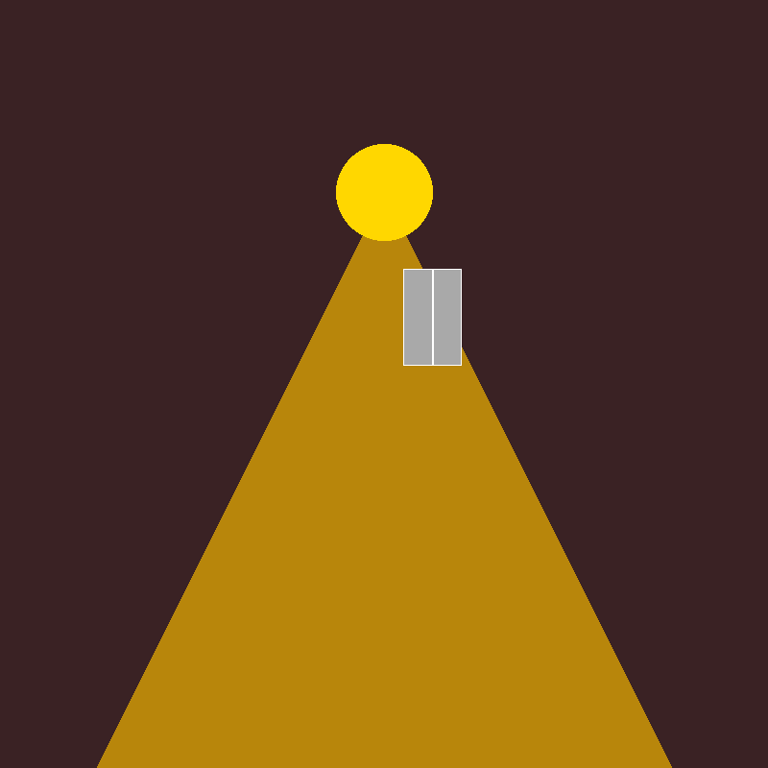
"For the law was given through Moses, but grace and truth came through Jesus Christ."
— John 1:17
A Necessary Preparation
The Law was a genuine act of grace and preparation.
Moses delivered the message; Christ is the message Himself.
The Key Distinction
Rules describe the standard; the Incarnation reveals the Lawgiver's heart.
Old and New Testaments are progressive revelation, not opposition.
Patristic Insight & Analogy
St. Irenaeus: "The Law was a schoolmaster preparing humanity for Christ."
Like receiving a letter from a loved one versus meeting them in person.
The letter is true and precious, but the person is infinitely more.
John 1:17 | Slide 13 of 15
Notes:
Resist the temptation to pit Moses against Christ. That's a Marcionite error and it's everywhere in popular Christianity. The Orthodox reading is continuity with escalation. Moses brought a letter from God. Christ IS God. The letter isn't cancelled — it's fulfilled. Irenaeus's schoolmaster image is perfect: a good teacher doesn't become irrelevant when the student meets the principal. The teacher served the principal's purpose all along. The letter analogy should hit emotionally — everyone knows the difference between reading about someone and meeting them face to face.

Slide 12

"No one has ever seen God; the only God, who is at the Father's side, He has made Him known." — John 1:18
Christ as the 'Exegesis'
The Prologue closes with a staggering claim. No human being—not even Moses or Elijah—has ever seen God's essence directly.
Past visions were theophanies (partial manifestations).
The Son eternally dwells 'in the bosom of the Father' (εἰς τὸν κόλπον τοῦ Πατρός), indicating the deepest intimacy.
He has 'made Him known' (ἐξηγήσατο)—the Greek root from which we derive 'exegesis'.
Christ is the visible expression of the invisible Father; there is no hidden God behind Christ who contradicts what Christ reveals.
Essence vs. Energies
God's Essence (ousia) remains forever beyond human comprehension.
God's Energies (energeiai)—His love, grace, power, light—make Him genuinely known and accessible to humanity.
Christ is the definitive, unsurpassable self-communication of God to creation.
St. John of Damascus:
"We do not know God in His essence — that remains forever beyond us. But we know God truly and fully in His Son, who is the perfect image of the Father."
The Mandylion (Holy Face): Traditional Byzantine icon representing the unseen God making Himself visible through Christ.
John 1:18 | Slide 14 of 15
Notes:
The word 'exēgēsato' is stunning. We use 'exegesis' to mean interpreting a text. John says Christ is the exegesis of God — He interprets the Father for us. No one has seen the essence, but the Son has made the Father known through His energies. The essence/energies distinction is unique to Orthodox theology and it matters: it means God is genuinely knowable without being fully comprehensible. The Mandylion icon is the perfect visual — God's face made visible, not by human effort but by divine self-revelation.

Slide 13
What John's Prologue Means for Your Life Today
1. Christ is eternal God, not a created being.
He was not promoted to divinity or adopted as God's Son. He is God from God, Light from Light — before all worlds, before all time. Your faith rests not on a good teacher but on the Creator of the universe.
2. The Incarnation is the most important event in human history.
God did not send a message, a prophet, or an angel. He came Himself. He took on your flesh, your hunger, your tears, your death — so that you could share in His life, His joy, His immortality.
3. You are invited into theosis — becoming like God by grace.
This is not arrogance; it is the entire point of Christianity according to the Fathers. Through the sacraments, through prayer, through a life of love and repentance, you are being transformed from glory to glory.
4. The light cannot be overcome.
Whatever darkness you face — grief, sin, doubt, fear, illness, injustice — it cannot extinguish the light of Christ. Darkness has never once defeated light. Not at Calvary. Not in your life.
5. Grace upon grace is your inheritance.
God's mercy is not a one-time offer. It is continuous, inexhaustible, and it reaches you exactly where you are right now — today, in this moment, in this seat.
And the Word became flesh and dwelt among us, and we have seen His glory. — John 1:14
John 1:1–18 | Slide 15 of 15
Notes:
This is the landing. Don't add new content — drive home what was said. Read each takeaway slowly. Let number 4 breathe — people in the room are carrying real darkness right now. Number 5 is the invitation: grace reaches you in this seat, today, right now. Close with John 1:14 read aloud. Then silence. Let the Word dwell among them.

